Slide 1
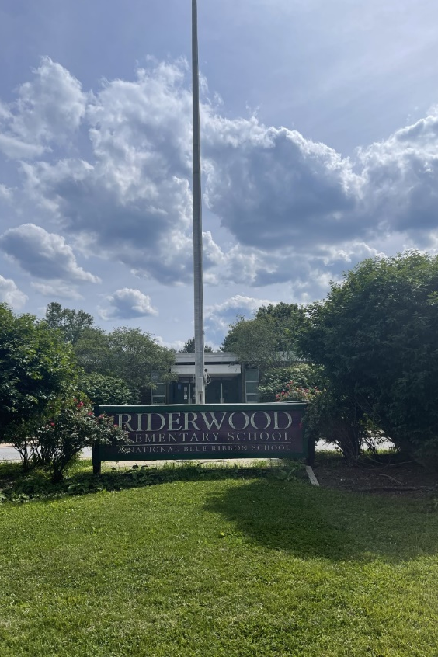
WE ARE HIRING!
Riderwood Elementary School
We are hiring ADDITIONAL ADULT ASSISTANTS!
If you are interested in becoming a part of the Riderwood team, please contact
Robyn Buckheit, Assistant Principal at
443-809-3568 or email rbuckheit@bcps.org
Office hours: 8:00-3:00
Hourly Rate: $14.00 plus $4.00 grant money equals $18.00)
.
Home of the raccoons
Kindergarten -5th grade and Integrated Learning Students
August 28- June 14
1711 Landrake Road Towson, Maryland 21204
Baltimore County Public Schools
Application on bcps.org
Notes:
To change this flyer, replace our sample content with your own. If you'd rather start from a clean slate, press the New Slide button on the Home tab to insert a new page. Now enter your text and pictures in the empty placeholders.

